Slide 1
Thesis Plan
Separating Cyslostationary Signals using the Nonlinear Dynamics of Continuous-Time Recurrent Neural Networks

Slide 2
Motivation
Current machine learning paradigms don’t resemble the brain
Reservoir computing methods, especially Liquid State Machines, provide a biologically plausible computational framework
This work will investigate the liquid state machine framework with an emphasis on the nonlinear delay dynamics that arise from realistic distributions of synapse lengths and signal propagation times
The work will focus on recognizing stationary and cyclostationary time series

Slide 3
Novel contributions
This research will explore the effect of realistic distance-based synaptic propagation times on the computational power of the neural circuit
This research will explore the contribution of spatial organization and disorganization
This research will examine the ability of neural circuits to separate cyclostationary signals

Slide 4
Current status
Implemented Izhekevich neural dynamics, first order synapse dynamics, and variable synaptic propagation times in MATLAB
Constructed columnar neural microcircuits with distance-dependent connectivity and synaptic delay
Demonstrated separation property of this neural circuit

Slide 5
Reservoir Computing
Nonlinear reservoir with fading memory is driven by an input
The input evokes complex dynamics in the reservoir
A linear readout map extracts the desired data from the reservoir
Multiple readouts can be trained with simple regression to extract different information from the same reservoir
Separated into machine learning (Echo State Machines) and biologically plausible neural dynamics (Liquid State Machines)

Slide 6
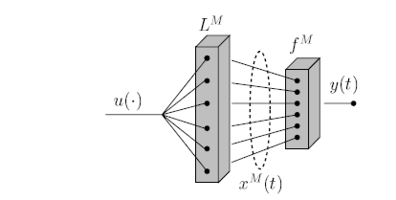
Liquid State Machines
The reservoir can be viewed as a nonlinear filter L^{M} that transforms an input u into an M-dimensional state vector x^{M}
Multiple readout functions f^{M} then map the state vector onto the desired output(s) y
Readout functions are trained independently, reservoir is not trained
“Real-Time Computing Without Stable States: A New Framework for Neural Computation Based on Perturbations”, W. Maas, T. Natschlager, H. Markram

Slide 7
Liquid state machine reservoirs
Neural circuits have been used extensively as LSM reservoirs
Common topology is a column on a unit grid, initial work used a 3x3x15 column of 135 LIF neurons
Neuron connectivity is distance-based, biologically plausible connectivity has been shown to provide the best reservoir dynamics
Propagation times have NOT been modeled realistically, typically the propagation time down any synapse is not length-dependent

Slide 8
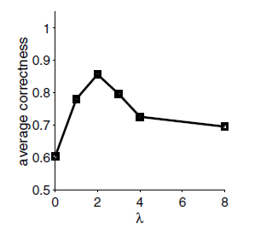
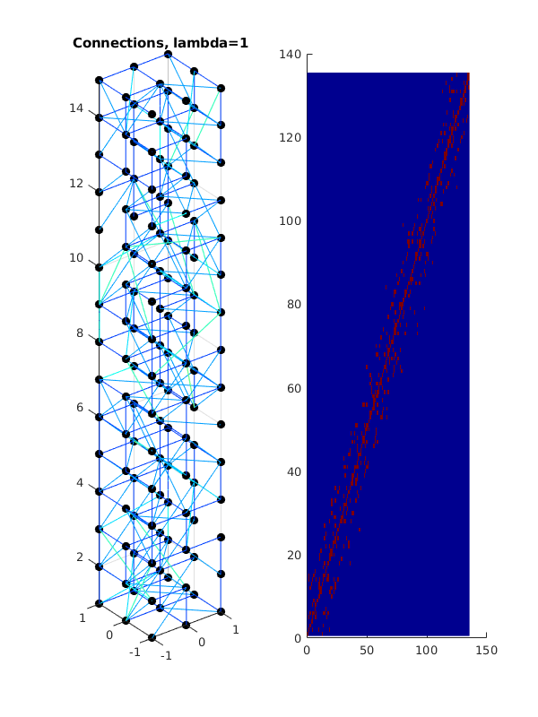
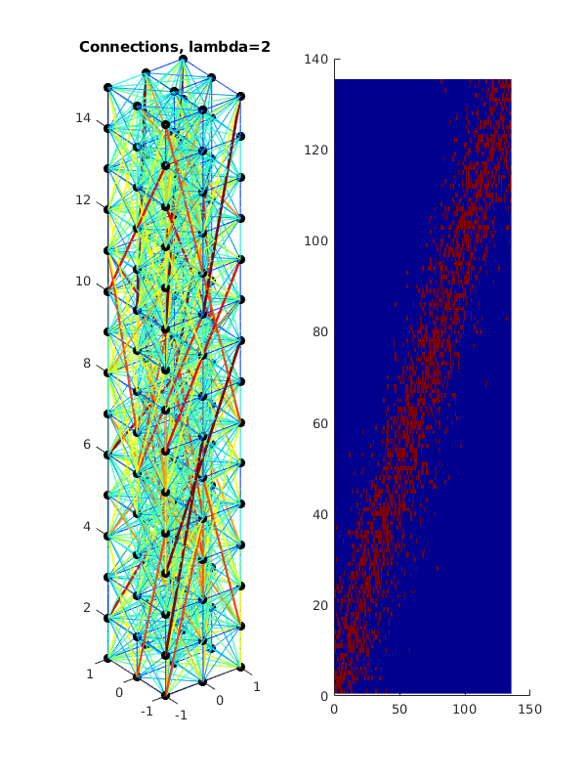
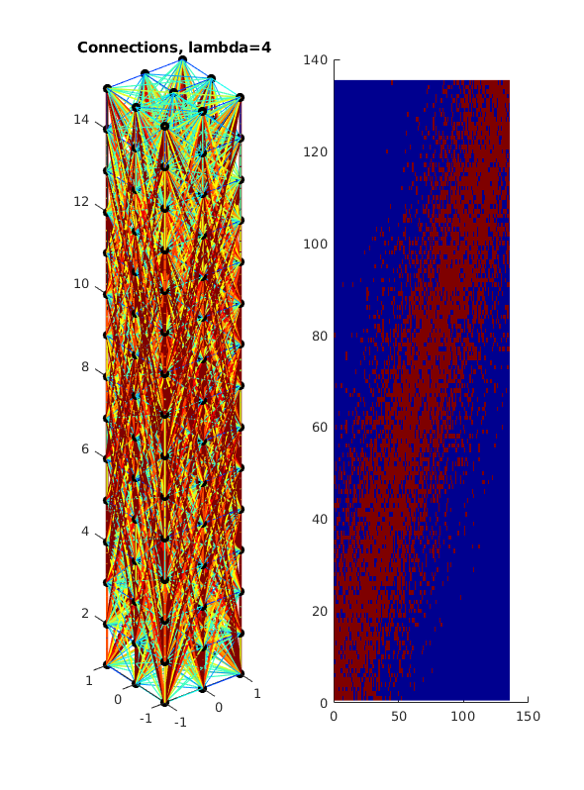
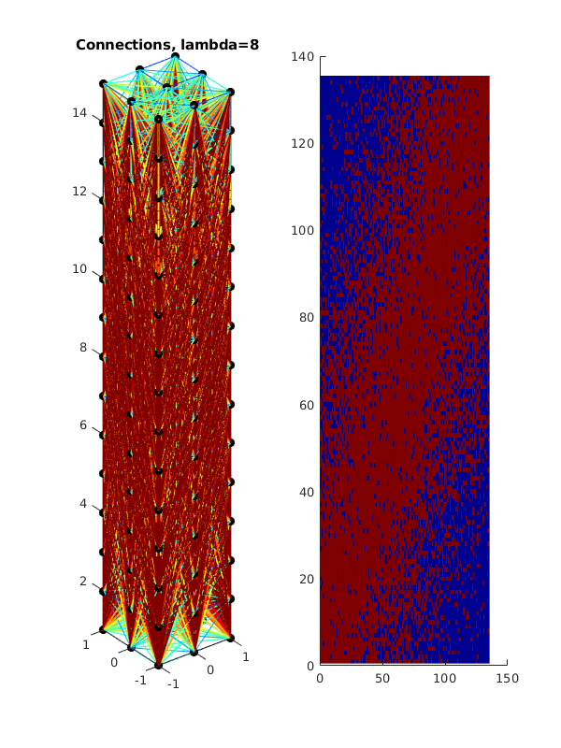
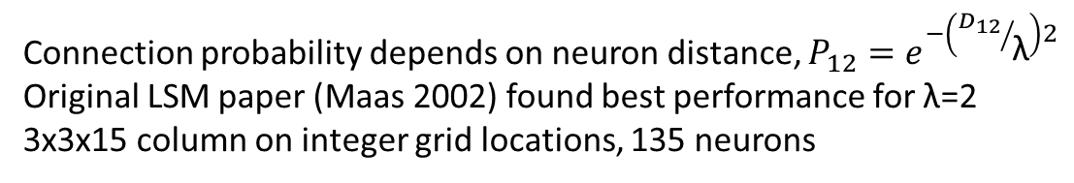
Neural connectivity
Connection probability depends on neuron distance, $P_{12}=e^{−\left({D_{12}}/{\text{λ}}\right)2}$
Original LSM paper (Maas 2002) found best performance for λ=2
3x3x15 column on integer grid locations, 135 neurons

Slide 9
Fidelity spectrum of neural models
Simplified computational models
High-fidelity biological models
Increasing dynamic fidelity, increasing computational requirements
Perceptron:
Weighted sum of input values
No dynamic behavior
Not spiking
I-F:
Simple decay
Basic spiking mechanism
Izhikevich:
Two coupled differential equations
Four parameters
Replicates observed spiking patterns
Hodgkins-Huxley:
Four coupled differential equations
>10 parameters
Corresponds to known ion channels
This work lives here, numerical integration in MATLAB and NEURON

Slide 10
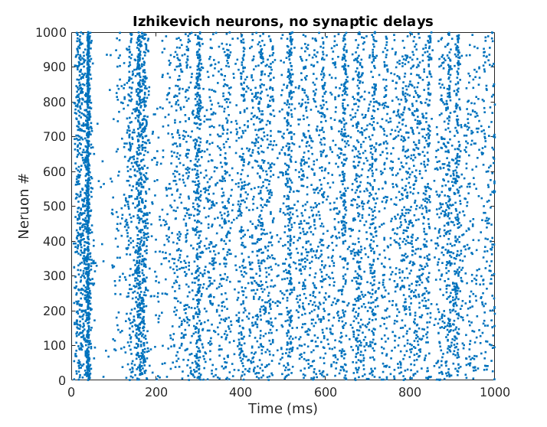
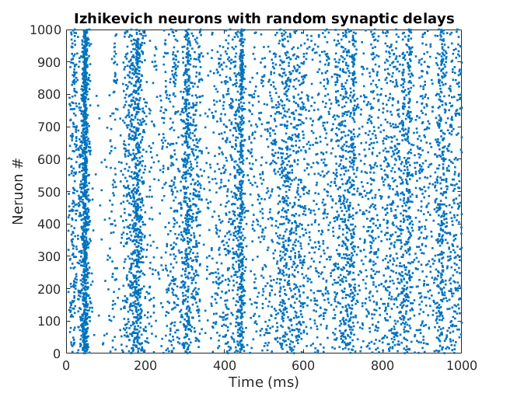
Neural dynamics
Created a neural simulation using the Izhikevich model for neural dynamics, added synaptic delays.
Validated synaptic delay implementation against Izhikevich ‘03 code, using the same parameters and inputs we see similar behavior.
Classic Izhikevich (2003)
With random synaptic delays 0-4 ms

Slide 11
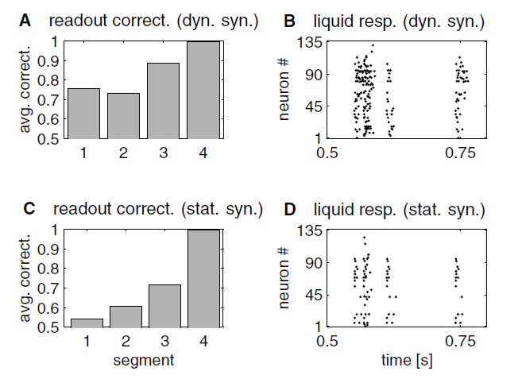
Synapse dynamics
Maas et al showed that dynamic synpases provide longer fading memory
Implemented first-order synapse dynamics
Synaptic delays based on inter-neuron distances
Maas2002 demonstrated that dynamic synapses (top) provided better classification on a four-element characterization problem compared to static synapses (bottom)

Slide 12
Stationary and cyclostationary signals
Stationary signals have constant statistical properties over time
Cyclostationary signals have statistical properties that vary cyclicly over time
Autocorrelation function is periodic
Leads to cyclic autocorrelation function and cycle frequencies
Periodic and PPM spike train plots

Slide 13
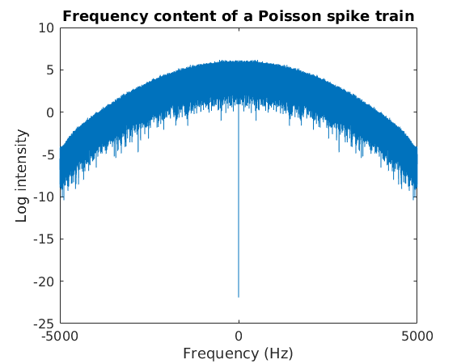
Poisson spike trains
Average firing rate R with Poisson statistics
No frequency content visible at R
Gaussian spikes
De-meaned data
Mean ISI = 0.052 (R=20 Hz)
Std of ISI = 0.055

